Slide 1


Seminar presentation on L Sealer Automatic Machine (L-SAM)
Jayawant Shikshan Prasarak Mandal’s
JSPM Narhe Technical Campus
Rajarshi Shahu School of Engineering and Research
Department of E&TC Engineering

Slide 2
L-Sealer Machine
By – 1) Asmita B. Gate (9)
2) Vedant M. Kalamkar (11)
3) Sangmeshwar S. Karanjkar (12)
4) Kiran S. Zagade (31)
Internal Guide:- Prof. H. N. Patil

Slide 3
Contents -
Objectives
Problem definition
Introduction
Function of packing machine
Block diagram
Circuit diagram
Hardware requirement
Software requirement
Result
Conclusion
Advantages
Limitations
Applications
References

Slide 4
Problem Definition-
To convert the Semi Automatic machine into fully Automatic machine which will be a time saving process and also will increase productivity.

Slide 5
Introduction-
Packaging machines are machines that performs complete stages of the packaging process. Examples include filling machines, sealing machines, wrapping machines, strapping machines, labeling machines and coding machines.
Packaging machines have advantages such as reducing labor costs associated and increasing the efficiency of the packaging process through the use of automation.

Slide 6
Function of packaging machine-
Machinery plays increasingly important roles such as: 1) Handle specialized requirements, such as vacuum packaging , inflatable packaging, skin packaging and pressure filling.
2)Reduce the time for packaging.
3) Reduce labor and improve working conditions for bulky/heavy products. 4) Protect workers from health effects brought by dust, toxic/hazardous products and prevent environmental contamination.

Slide 7
Block diagram:-
POWER
SUPPLY
ATMEGA 328
MOTOR DRIVER IC
L293D
IR SENSOR 1
MOTOR 1
IR SENSOR 2
RELAY
L CUTTER

Slide 8
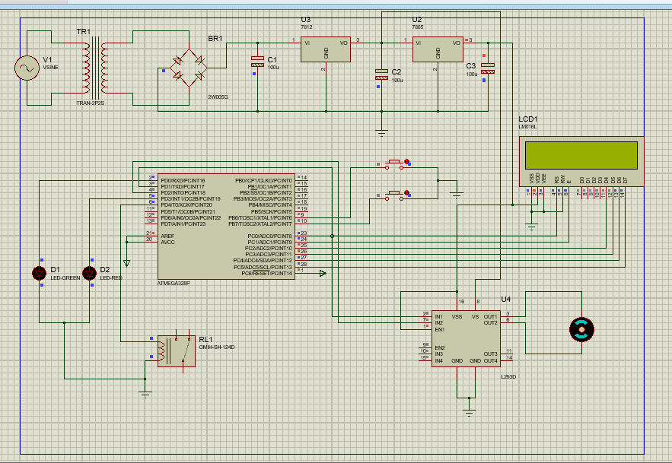
Circuit diagram-

Slide 9
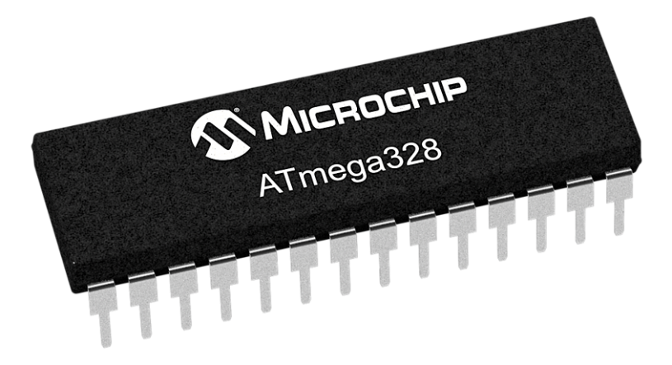
Hardware requirements
1) ATMEGA 328
High Performance, Low Power AVR® 8-Bit Microcontroller
• Advanced RISC Architecture
– 131 Powerful Instructions – Most Single Clock Cycle Execution
– 32 x 8 General Purpose Working Registers
– Up to 20 MIPS Throughput at 20 MHz
– On-chip 2-cycle Multiplier

Slide 10
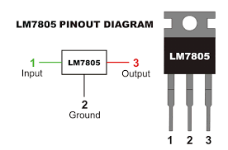
2)7805 & 7812 Regulator
The voltage source in a circuit may have fluctuations and would not give the fixed voltage output. The voltage regulator IC maintains the output voltage at a constant value. The xx in 78xx indicates the fixed output voltage it is designed to provide. 7805 provides +5V regulated power supply.

Slide 11
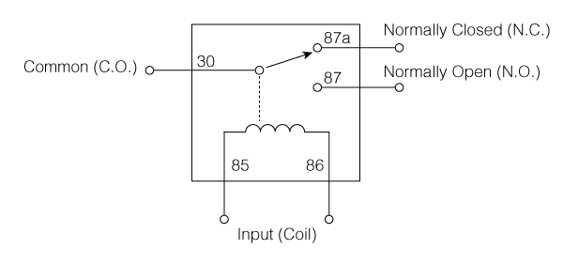
3)Relay
It works on the principle of an electromagnetic attraction. When the circuit of the relay senses the fault current, it energises the electromagnetic field which produces the temporary magnetic field. The current flows through the coil produces the magnetic field around it.

Slide 12
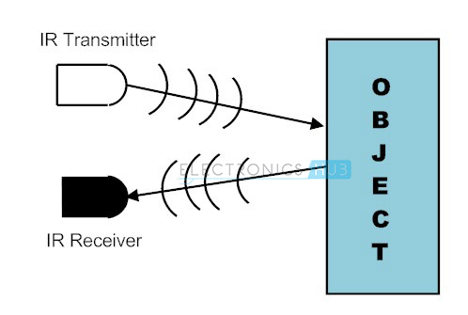
4)IR sensor
The IR Sensor-Single is a general purpose proximity sensor. The module consist of a IR emitter and IR receiver pair. The high precision IR receiver always detects a IR signal. The module consists of 358 comparator IC.
The output of sensor is high whenever it IR frequency and low otherwise.

Slide 13
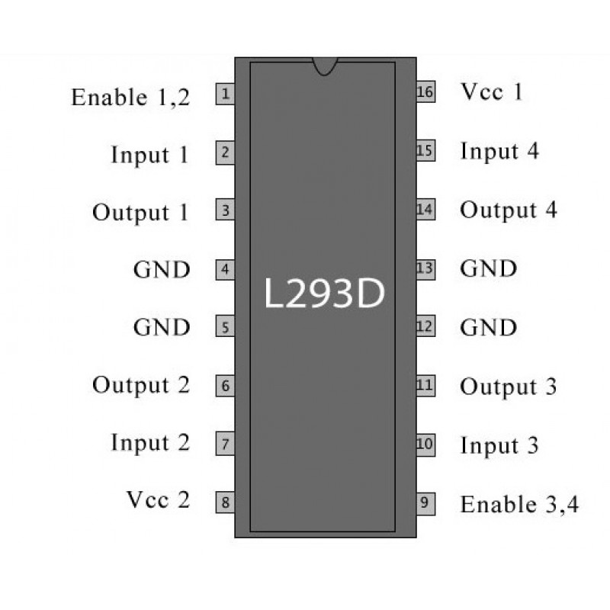
5) MOTOR DRIVER IC (L293D)
There are 4 input pins for l293d, pin 2,7 on the left and pin 15 ,10 on the right as shown on the pin diagram.
Left input pins will regulate the rotation of motor connected across left side and right input for motor on the right hand side.
The motors are rotated on the basis of the inputs provided across the input pins as LOGIC 0 or LOGIC 1.

Slide 14
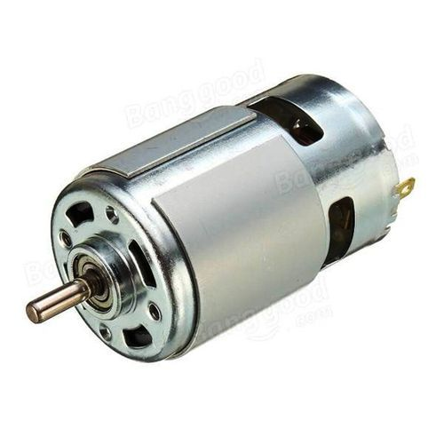
6) DC MOTOR
A motor is an electrical machine which converts electrical energy into mechanical energy. The principle of working of a DC motor is that "whenever a current carrying conductor is placed in a magnetic field, it experiences a mechanical force".

Slide 15

Software Requirements
1) Proteus software
The Proteus Design Suite is a proprietary software tool suite used primarily for electronic design automation. The software is used mainly by electronic design engineers and technicians to create schematics and electronic prints for manufacturing printed circuit boards.

Slide 16

2) ARDUINO IDE
Arduino consists of both a physical programmable circuit board (often referred to as a microcontroller) and a piece of software, or IDE (Integrated Development Environment) that runs on your computer, used to write and upload computer code to the physical board.

Slide 17
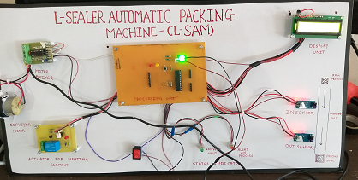
RESULT
System Results
Above experimental setup of l sealer automatic packaging machine.ir sensor sense the object and pack the object by polythene then send it for next process through conveyor.

Slide 18
CONCLUSION
The industries were using the semi automatic machine and some of the machines were plc based. IN our project we have perform the conversion of semi automatic machine to fully automatic machine.

Slide 19
Advantages of Automatic L sealer over Manual L sealer -
Reduction in production time.
Increase in accuracy & repeatability.
Less human errors.
Less employee cost.
Increased safety.
High volume production.

Slide 20
Limitations of Automatic L sealer over manual operated L sealer -
Less Versatility.
Large initial investment.
Increase in unemployment.

Slide 21
Applications:-
Medical, Pharmaceuticals
Hardware & Electronics product
It is used in Food materials
Toys,Sports,Crafts.

Slide 22
References
[1]Pressman, Abraham I. (1998), Switching Power Supply Design (2nd ed.), McGraw-Hill, ISBN 0-07-052236-7\
[2]Ms. Swarupa Kulkarni (2014), Automatic Sealing Machine For Metal Container
[3] Steven f. Barrett (2013), Arduino microcontroller processing for everyone! Third edition
[4] http://www.warade.in/
[5]https://www.youtube.com/results?search_query=semi+automatic+packaging+machine
[6] https://www.proto-electronics.com/

Slide 23
Thank you

